Slide 1
Objectives
In this session, you will learn to:
  Map sample data structure into database entities
  Design a web application to integrate with a DBMS
  Configure a DataSource and Java Naming and Directory InterfaceTM (JNDI) API
Notes:
Start the session by explaining the objectives listed in Slide 1. A DBMS is a robust, persistent storage tool. The JDBC API provides an abstract API to a variety of RDBMS vendor implementations. For large, maintainable web applications, the web tier should not directly interact with the resource tier. Instead, the data integration tier should reside between the business tier and the resource tier. Proper data integration is the purpose of the data access object (DAO) pattern.
Because of the separation of web and resource tiers, there is little work for the web component developer to do. Therefore, this module focuses on the design issues that lead to the DAO pattern.
Use the following flow in this module:
● Understand what a database management system (DBMS) does
● Design a web application to integrate with a DBMS
● Configure a DataSource and Java Naming and Directory Interface (JNDI) API
Exercise 1: Create the DVD library database
Exercise 2: Refactor the DVD application to use the database

Slide 2
Designing a Web Application
Design the domain objects of your application
Design the database tables that map to the domain objects
Design the business services (the model) to separate the database code into classes using the data access object (DAO) pattern
Notes:
Use this slide to explain about designing a Web application. The order of the tasks given in the slide is not important. Typically, if the application is new, the development team would start with the design of the domain objects and design the DB tables afterward (or in parallel). Other times, an application is built on top of an existing database. In this case, the second task is done and the team must design the domain objects, and the mapping, between the tables and the objects.

Slide 3
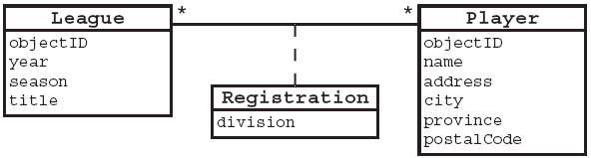
Domain Objects
The following are the domain objects in Soccer League web application:
The objectID has been added to the classes to provide a unique ID in the database (DB) table for each of these entities.
Notes:
Use this slide to explain about the domain objects.

Slide 4
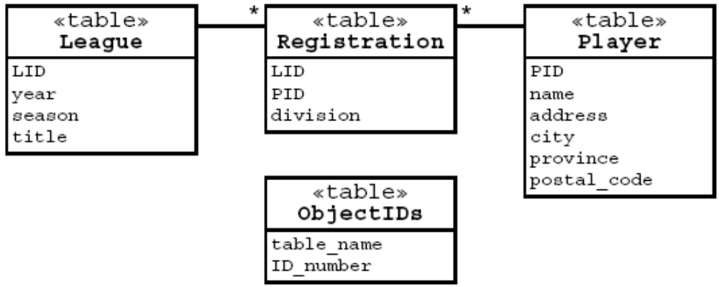
Database Tables
The following is one possible DB design for the domain objects:
The objectID in the Java technology object corresponds to the ID in the database table. For example, the objectID in the League objects corresponds to the LID in the League table.
Notes:
Use Slides 4 and 5 to explain about the database tables.

Slide 5
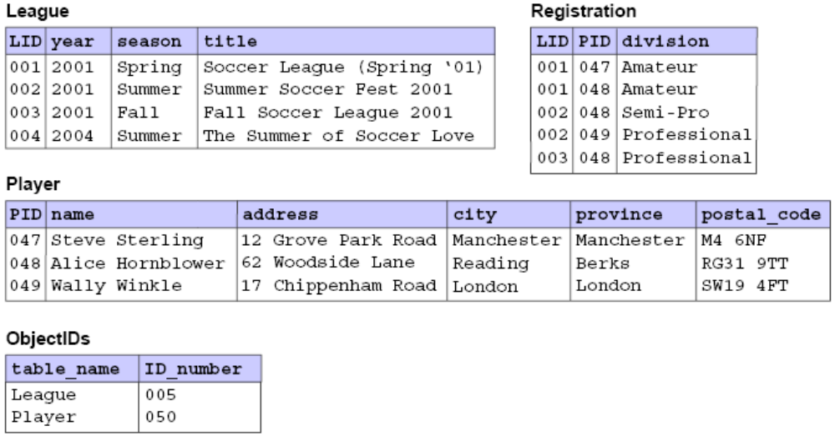
Database Tables (Contd.)
Example data:
Notes:
In this slide, note that the Player table is not normalized. To be normalized, the city, province, and postal_code elements should be in a separate table.

Slide 6
Data Access Object (DAO) Pattern
The data access object (DAO) pattern separates the business logic from the data access (data storage) logic.
The data access implementation (usually JDBC technology calls) is encapsulated in DAO classes.
The DAO pattern permits the business logic and the data access logic to change independently.
For example, if the DB schema changes, then you would only need to change the DAO methods, and not the business services or the domain objects.
Notes:
Use this slide to explain about the Data Access Object (DAO) pattern.

Slide 7
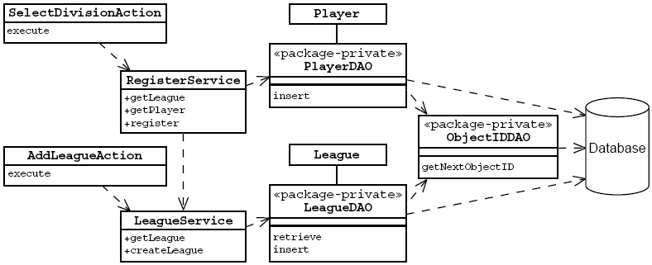
Data Access Object Pattern
Notes:
Use this slide to explain about Data Access Object pattern. In the figure, the stereotype package-private is used to indicate that the DAO classes use the default access mode, as opposed to public. Using package-private hides the DAO classes from other packages. For example, the servlet classes will not have access to the DAOs.

Slide 8
DAO Pattern Advantages
Business logic and data access logic are now separate.
The data access objects promote reuse and flexibility in changing the system.
Developers writing other servlets can reuse the same data access code.
This design permits changes to front-end technologies.
This design permits changes to back-end technologies.
Notes:
Use this slide to explain about the advantages of the DAO pattern.

Slide 9
JDBCTM API
The JDBCTM API is the Java technology API for interacting with a relational DBMS.
The JDBC API includes interfaces that manage connections to the DBMS, statements to perform operations, and result sets that encapsulate the result of retrieval operations.
Techniques are described for designing and developing a web application, in which the JDBC technology code is encapsulated using the DAO design pattern.
An incorrect technique is to create a connection object for each request, but this approach is extremely slow and does not scale well.
Notes:
Use this slide to explain about the JDBC API. Show the database version of the Soccer League example. The user interface of the web application has not changed, so you should concentrate on showing the change in the database. Bring up a terminal window and launch the SQLMonitor program. Before performing a registration, show the League
table, which is populated with a few league objects. Also show the Player and Registration tables, which
should be empty. Perform a typical registration, go back to the SQLMonitor program, and show the updated
Player and Registration tables. Build the examples/database/ lab files directory and use the
http://localhost:8080/database/ URL.

Slide 10
Traditional Approaches to Database Connections
Have you developed a web application that connects to a database?
How did you make connections in the web application?
What problems did you experience?
Notes:
Use Slides 10 and 11 to explain about the traditional approaches to database connections.

Slide 11
Traditional Approaches to Database Connections (Contd.)
Use DriverManager.getConnection to create database connections with every request.
Create a connection and store it as a member variable of the servlet.
Use a connection pool to recycle connections.
Can use servlet context to store the connection pool:
  A custom connection pool might present maintenance problems.
  Servlet context is not available to business tier components (such as DAOs).

Slide 12
Using a DataSource and JNDI API
Java EE application servers provide a namespace, which can be accessed using JNDI APIs.
Java EE application servers must support storing DataSource resources in JNDI namespace.
DataSource is an object which encapsulates the information to connect to the database:
  Database URL
  Driver
  User name and password
Most servers provide a database connection pool that is accessed using the DataSource.
Notes:
Use this slide to explain about using a DataSource and JNDI API. A DataSource object works with a Java Naming and Directory Interface (JNDI) naming service and is created, deployed, and managed separately from the applications that use it.
An application can use JNDI to find and access remote services over the network. The advantages of using a DataSource object registered with a JNDI naming service are:
It makes code more portable.
It makes code much easier to maintain.
For example, if a database is moved to a different server, only the serverName property of the DataSource object needs to be updated.

Slide 13
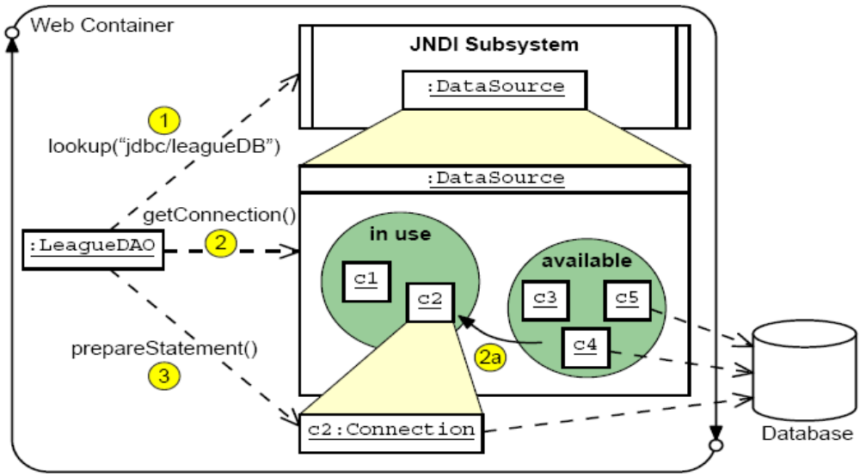
Application DataSource Use
Notes:
Use Slides 13, 14, and 15 to explain about how DataSource is used in an application.

Slide 14
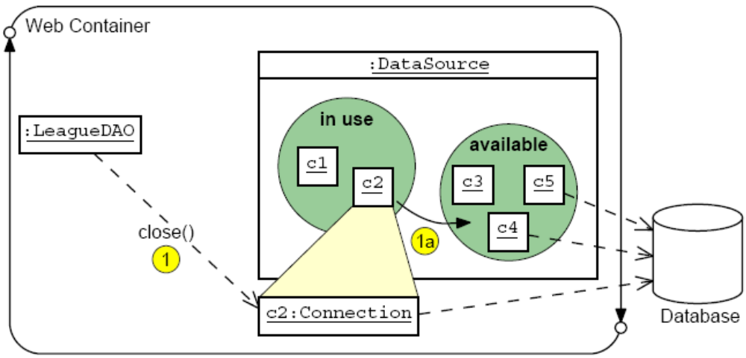
Application DataSource Use (Contd.)

Slide 15
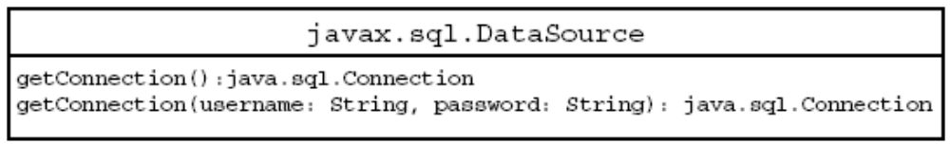
Application DataSource Use (Contd.)
The DataSource API:
Locate DataSource using JNDI lookup:
  52 Context ctx = new InitialContext();
  53 if ( ctx == null ) {
  54 throw new RuntimeException(“JNDI Context could
  not be found.”);
  55 }
  56 ds = (DataSource)ctx.lookup
  (“java:comp/env/jdbc/leagueDB”);
  57 if ( ds == null ) {
  58 throw new RuntimeException(“DataSource could
  not be found.”);
  59 }

Slide 16
Configuring a Sun Java Application Server DataSource and JNDI
JNDI lookup needs to be defined in the web.xml deploymengt descriptor:
  81 <taglib-location>/WEB-INF/struts-tiles.tld
  </taglib-locati
  82 </taglib>
  83 </jsp-config>
  84 <resource-ref>
  85 <res-ref-name>jdbc/dvdLibraryDB</res-ref-name>
  86 <res-type>javax.sql.DataSource</res-type>
  87 <res-auth>Container</res-auth>
  88 <res-sharing-scope>Shareable</res-sharing-scope>
  89 </resource-ref>
  90 </web-app>
Notes:
Use this slide to explain about configuring a Sun Java Application Server DataSource and JNDI.

Slide 17
Sun Java Application Server DataSource sun-web.xml Configuration
1 <?xml version="1.0" encoding="UTF-8"?>
2 <!DOCTYPE sun-web-app PUBLIC "-//Sun Microsystems,
Inc.//DTD Application Server 8.1 Servlet 2.4//EN“
"http://www.sun.com/software/appserver/dtds/
sun-web-app_2_4-1.dtd">
3 <sun-web-app error-url="">
4 <context-root>/dvd</context-root>
5 <resource-ref>
6 <res-ref-name>jdbc/dvdLibraryDB</res-ref-name>
7 <jndi-name>jdbc/dvdLibraryDB</jndi-name>
8 </resource-ref>
9 <class-loader delegate="true"/>
10 <jsp-config>
11 <property name="classdebuginfo" value="true">
12 <description>Enable debug info compilation in the
generated servlet class</description>
Notes:
Use this slide to explain about the DataSource configuration in the sun-web.xml file.

Slide 18

Demo: Integrating Web Applications With Databases
Demo: Integrating Web Applications With Databases
Notes:
In this demo, you demonstrate the use of filters in a Web application. You can run the project, DatabaseDemo, stored at Datafiles For Faculty\Session13\Demo1\mod10_database.zip file in the TIRM CD for demonstration.
Before running the DatabaseDemo project, you need to create a Java DB database by the name, league. Then you need to run the Sql script file, SL314_initializeDemo.sql stored in the db folder. This script will create four tables in the league database.

Slide 19
Summary
In this session, you learned:
  Most web applications need to interface to a resource tier (usually a relational database).
  The DAO pattern separates the business tier components from the resource tier.
  In Java EE technology-compliant web containers, the best solution to access a DB connection is by using a DataSource object that is stored under JNDI.
  The DataSource object provides a pool of DB connections.
  You must configure a JNDI DataSource resource in the deployment descriptor, but you also have to configure it in the web container.
Notes:
End the session by discussing the summary points as given in this Slide.

